Slide 1
Washington County Health Department
Strategic Plan

Slide 2
Purpose of this document
This Strategic Plan will serve to guide the operations of the Washington County Health Department for the next three to five years.

Slide 3
Agency Description
Jointly governed by the Maryland Department of Health and Mental Hygiene and the Washington County Board of County Commissioners. The Board of County Commissioners serves as the local Board of Health.
203 employees
Main office: 1302 Pennsylvania Avenue, Behavioral Health: 925 Burhans Blvd.
Residential facilities: CSAP, Cameo

Slide 4
Programs
Clinical: Family Planning, Breast and Cervical Cancer Prevention, STI, Tuberculosis control, immunizations, colon cancer screening, Healthy Families, Mother and Child Home Visiting, WIC, Adult Evaluation and Review Services, HIV counselling/testing/case management
Wellness and Health Promotion: Diabetes Prevention Program, Living Well (Chronic Disease Self-Management), Stepping On (fall prevention), Healthiest Maryland Businesses, Walking Initiative
Environmental: well/septic, food service inspection
Emergency Preparedness

Slide 5
Programs
Behavioral Health:
Comprehensive assessment and referral
- Pharmacotherapy / Medically assisted therapy
Outreach services to high risk populations
- Pregnant or postpartum women
- Women giving birth to a drug exposed newborn
- Women with children
- Motor Vehicle Administration (MVA) programs
- 3-Hour Alcohol and Drug Education Program
- Point System Conference Program
- Driver Improvement Program
- Community family education group
- -Drug testing
Employee Assistance Programs
- Substance Abuse Professional Evaluation and Follow-up
- 24-Hour Crisis Intervention
- HIV testing and counseling
- Criminal justice treatment services
- Long-term residential treatment for women with children (CAMEO)
- Long-term residential treatment for adolescents (CSAP)
- 12-Hour Alcohol Education Program
- Anger Management

Slide 6
County description
Population (July 1, 2016 estimate) 150,292 ¹
County seat: Hagerstown ¹
Area: 467 square miles ¹
Ages: under 5- 5.9%, under 18-22.2%, 65 and over – 16.2% ²
Race: white 83.9%, black or A/A 11.2%, Asian 1.8%, 2 or more races 2.7% ²
Ethnicity: Hispanic/Latino 4.5% ²

Slide 7
County description
Educational level: high school grad or higher – 86.7%, bachelor’s degree or higher – 19.9% ²
Disability: under 65 with disability 11.6% ²
Per capita income: $27, 066 ²
Persons in poverty: 12.0%²
Five largest employers: Meritus Medical Center, Citi, First Data, Volvo, FedEx ³
¹ Wikipedia ² UScensus.gov ³ Hagerstown/Wash Cty Chamber of Commerce

Slide 8
Strategic Planning Process
This strategic plan was developed in recognition of the need for an agency strategic plan for proactive and efficient operations that meet the needs of the community and to fulfill the requirement to have a strategic plan in place for application for PHAB accreditation. With the support of a technical assistance grant from NACCHO (National Association of County and City Health Officials), the WCHD contracted with Ascendient Healthcare Advisors to facilitate our Strategic Planning Retreat and assist in the development of the agency strategic plan.

Slide 9
Retreat Attendees
Health Department Accreditation Team Members Titles and Division
Anne Schooley, Operations and Compliance Coordinator, Behavioral Health
Brenda Cole, Purchasing Officer, Administration
Dawn Orndoff, Program Manager, Nursing
Dr. Diana Gaviria, Deputy Health Officer
Donna Stouffer, Billing Manager, Administration
Earl Stoner, Health Officer
Laura Bennett, Administrative Speccialist, Administration
Loan Vo, Program Supervisor, Nursing
Mary McPherson, Program Manager, Health Planning
Robert Kutchman, Environmental Health Specialist, Environmental Health
Robin Banfe, Nurse Case Manager, Nursing
Rod MacRae, Director, Health Planning
Additional In-House Staff Attending
Stacey Hornbecker, Administrative Assistant, Nursing
Shelby Hughes, Medicaid Eligibility Worker, Nursing
Lisa McCray, Communicable Disease Nurse, Nursing
Audra Nichols, Clinical Services Support Aide, Nursing
Susan Parks, Director, Nursing
Jess Schoppert, Personnel Officer, Administration
Vicki Sterling, Director, Behavioral Health
Shawn Stoner, Emergency Planner, Health Planning
Lou Trescott, Director, Environmental Health
Danielle Warren, Health Educator, Nursing
David Washington, Program Manager, Behavioral Health
Community Partners Attending
Adam Roberson, Community Free Clinic
Allen Twigg, Meritus
Kristin Mielcarek, Canaan Valley
Melissa Minotti, John Hopkins Universityy
Paul Frey, Chamber of Commerce
Brad Tritsch, Commission on Aging
Shelley Steiner, Hospice of Washington County
Kim Murdaugh, Exec. Director, Family Health Care of Hagerstown
Nikki Snyer, Department of Social Services
Bill Beard, Disabilities Board
Janice Howells, WCPS School Health Program Coordinator
Greg Lux, Director of Food Safety, Giant/Martins Food
Robbie Hill, Owner, HOH Well Drilling
Carol Costello, Supervisors of Student Services, WCPS
Edward Long, Assistant Warden, Washington County Sheriffs Office

Slide 10
Planning Process Components
Assess the Situation:
External/National Assessment
WCHD Situation Assessment
Survey Findings and Conclusions
SWOT Analysis
Phase I
WCHD Strategic Plan
Define Organizational Direction & Goals:
WCHD Mission, Vision and Values
WCHD Strategic Direction
WCHD Goals
Phase II
Develop Strategies & Implementation Plan:
WCHD Strategies
Implementation Plan (including tactics & timelines)
Final WCHD Strategic Plan
Phase III

Slide 11
Phase I: Assess the situation
Review the national, state, and local trends that will affect the health of Washington County residents and the operations of the WCHD
Define the local and agency context through surveys of staff and community partners and SWOT (Strengths, Weaknesses, Opportunities, Threats) Analysis

Slide 12

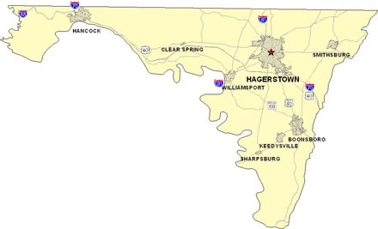

Key Components
External/National Factors
Pressure
Local/Washington County Health
Support
Internal/WCHD Activities

Slide 13
Situation Assessment Findings:
External/National Factors

Slide 14
External/National Factors:
Key Takeaways
Health reform is expected to continue to change the “role” of LHDs
Continued cost/spending growth is not sustainable...care must be “shifted” to lower cost settings
Prevention will become more of a priority...transitioning focus from sick care to true health care
Near-term the volume of direct care services likely to be impacted given increased insurance coverage/access
Increased patient accountability/participation is essential... but limited incentives and/or penalties likely present in the short-term
Increased coordination within LHDs, the community, and other governmental non-governmental organizations will be critical.

Slide 15
Total U.S. Healthcare Expenditures
It has taken us nearly 25 years to add the same amount of expenses expected in the next decade alone...this growth is not sustainable
$2.3 Trillion
Source: www.CMS.gov

Slide 16

Yes...We’re All Getting Older
2017
2030
Today for every person older than 65, there are approximately 5 people in the workforce*
In 2030 there will only be approximately 3 people in the workforce for every person older than 65.
40% Decrease
* (between the ages of 19 and 64)

Slide 17
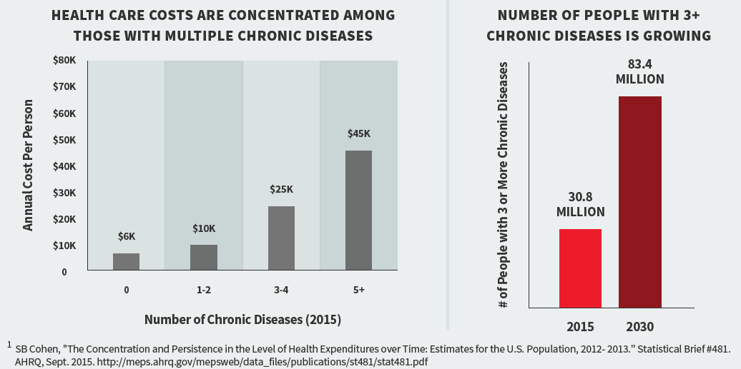
Majority of Cost is “Centralized”

Slide 18
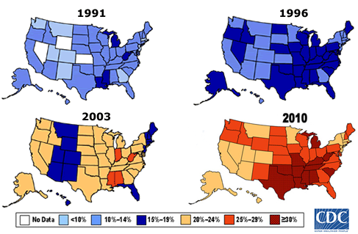
Rate of Obesity – 1991 to 2010
Percentage of the population with BMI ≥30 (30 lbs. overweight for 5’ 4” person)
Source: CDC Behavioral Risk Factor Surveillance Survey
Notes:
Virtually all of these conditions are caused or exacerbated by the obesity epidemic that has overtaken our population. Interestingly enough, we didn’t update this map for 2010 because you have to go through major machinations to get the same data ranges that the CDC was tracking in 1993. Rather than these data ranges that start at <10%, the CDC’s automatic data ranges for these data today now start at this third highest category, 24% or less. There’s no longer any blue on the 2010 map. That’s how far we’ve come, in a very disturbing and harmful way.

Slide 19

Care Has to be Delivered Differently
Improving the Health of Populations
Reducing the Per Capita Cost of Care
Improving the Patient Experience of Care

Slide 20





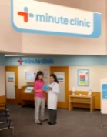

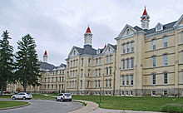


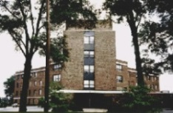







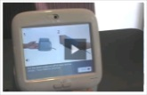
Increased Coordination and “Push” to Lower Cost Settings
Imaging Center
Surgery Center
Health Dept
Hospital
Academic Medical Center
Physician Office
Multi-Specialty Office
Urgent Care
Retail Clinics
Psychiatric Hospital
Rehab Hospital
Pharmacy
Community Mental Health
“HealthPlex”
F/S Emergency
Dialysis Center
Nursing Facility
Wellness
Home Monitoring
Hospice Facility
Mobile
Home

Slide 21
Total U.S. Healthcare Expenditures:
Projected Change By Type of Expenditure
Expenditure Category (‘16 Expenditure)
Projected 10-Year Increase
Source: www.CMS.gov
73%

Slide 22
External/National Factors:
Implications for WCHD
Health reform is expected to continue to change the “role” of LHDs
Continued cost/spending growth is not sustainable...care must be “shifted” to lower cost settings
Prevention will become more of a priority...transitioning focus from sick care to true health care
Near-term the volume of direct care services likely to be impacted given increased insurance coverage/access
Increased patient accountability/participation is essential... but limited incentives and/or penalties likely present in the short-term
Increased coordination within LHDs, the community, and other governmental non-governmental organizations will be critical.

Slide 23
National Factors:
Impact on 10 Essential Public Health Services
Any major public health activity should be able to fit into at least one of these 10 essential services:
Monitor health status to identify and solve community health problems.
Diagnose and investigate health problems and health hazards in the community.
Inform, educate, and empower people about health issues.
Mobilize community partnerships and action to identify and solve health problems.
Develop policies and plans that support individual and community health efforts.

Slide 24
National Factors:
Impact on 10 Essential Public Health Services
Enforce laws and regulations that protect health and ensure safety.
Link people to needed personal health services and assure the provision of health care when otherwise unavailable.
Assure competent public and personal health care workforce.
Evaluate effectiveness, accessibility, and quality of personal and population-based health services.
Research for new insights and innovative solutions to health problems.

Slide 25
Situation Assessment Findings:
State Considerations

Slide 26
Key State Considerations
The Maryland Department of Legislative Services (MDLS) released a report in 2013, titled Survey of Local Health Departments in Maryland. The report and research provides one of the most comprehensive looks at health departments across the State and was completed in order to assess:
How LHD finance public health services;
The impact of health care reform on LHD; and,
The regionalization of public health services in the State.

Slide 27
State Considerations:
Key Findings
“Upon full implementation of the federal health reform the role of LHDs in Maryland will likely change.”
Services related to communicable disease surveillance, as well as environmental health programs, such as those related to food safety, will largely go unaffected; however, the volume of direct care services provided by LHDs will change to the extent that a greater percentage of individuals begin to obtain private insurance.
Accordingly, LHDs must determine whether it is advisable for them to continue to provide direct care services within their jurisdictions. (Some LHDs in Maryland have already moved away from providing direct care, either by choice or due to State and local budget cuts.) ...It is critical that LHDs examine the services that they provide and adjust to the evolving health care system.

Slide 28
MD Health Department Revenues

Slide 29
MDLS Findings –
Local Health Department Revenues
Category | Maryland | Washington
County Sources | 28% | 26%
Federal Pass-through | 18% | 46%
Other DHMH Grants | 17% | -
Federal-direct | 10% | 8%
Collections | 10% | 12%
Core Funding | 6% | 7%
Funding from Other State Agencies | 6% | -
CRF Grants | 2% | 2%
Private Organizations | 2% | -
Other | 1% | -
Total (in millions) | $ 639.0 | $22.9

Slide 30
MD Health Department Expenditures

Slide 31
MDLS Findings –
Local Health Department Expenditures
Category | Maryland | Washington
Maternal and Child Health | 20% | 28%
Substance Abuse | 14% | 12%
Communicable Disease Control | 13% | 2%
Environmental Health | 10% | 5%
Admin and Communications | 9% | 9%
Adult and Geriatric Health | 7% | 8%
Mental Health | 6% | 12%
Family Planning | 3% | 3%
Wellness Promotion | 3% | 13%
Emergency Preparedness | 3% | 1%
Other | 13% | 6%
Total (in millions) | $ 622.1 | $16.2

Slide 32
Key State Considerations:
Implications for WCHD
Health reform is expected to change the “role” of LHDs in Maryland...
In many instances we believe the role of LHDs will increase in importance post-reform...due to greater focus on health vs. sick care.
Near-term the volume of direct care services likely to be impacted given increased insurance coverage/access...
Increasing the importance of “collections” and third-party contracting.
Increased importance expected to be placed on collaboration and coordination both within LHDs as well as with other governmental and non-governmental organizations.

Slide 33
Situation Assessment Findings:
Local/Washington County Health

Slide 34
Market Profile:
Growth and Demographics
Washington County
Maryland
Age Group
<15
15-44
45-64
65+
2016 Est. | 2021 Est. | CAGR
27,117 | 26,618 | -0.4%
57,879 | 58,608 | 0.3%
42,054 | 41,236 | -0.4%
24,566 | 28,223 | 2.8%
2016 Est. | 2021 Est. | CAGR
1,118,832 | 1,120,943 | 0.0%
2,388,784 | 2,479,164 | 0.7%
1,650,380 | 1,643,140 | -0.1%
880,129 | 1,051,669 | 3.6%
Total
151,616 | 154,685 | 0.4%
6,038,125 | 6,294,916 | 0.8%
Median Age
40.5 | 41.0
38.7 | 39.4
% Below Poverty*
12.9%
10.0%
Source: Esri Population Forecasts & American Community Survey (US Census Bureau)
*American Community Survey 5-Year Estimate (2011-2015)

Slide 35
Market Profile:
Community Need Index (CNI) Introduction
Nation’s first standardized Community Need Index
Identifies the severity of health disparity for every zip code in the U.S. based on multiple social and economic factors known to limit health care access
Indicator scores are obtained for the areas of income, culture, education, insurance, and housing and a barrier score of 1.0 (low need) to 5.0 (high need) is applied
Communities with a higher CNI are generally shown to utilize care at a higher rate...for example, hospital admission rates of 5.0 CNI communities are 60% higher than l.0 CNI locations

Slide 36
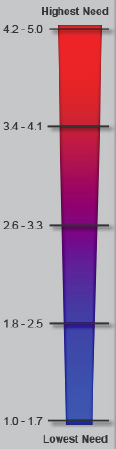
Market Profile:
Washington County CNI by Zip Code
Washington County’s mean CNI is 2.5, with Hagerstown (21740) having the highest CNI at 4.0.
For comparison purposes, Frederick County’s mean CNI is 1.9, and Baltimore City has one of the highest CNIs is Maryland at 4.4
Source: Dignity and Truven Health Community Need Index

Slide 37
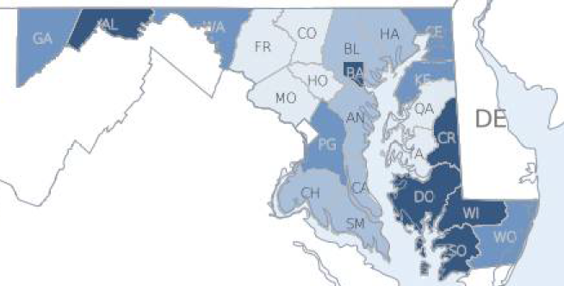
Market Profile:
2016 Health Factor Rankings
Washington County Ranked 18th For Health Factors in Maryland
State Rank
1-6
7-12
13-18
19-24
Source: Robert Wood Johnson Foundation, County Health Rankings

Slide 38
Market Profile:
2016 Health Outcomes Rankings
Washington County Ranked 15th For Health Outcomes in Maryland
State Rank
1-6
7-12
13-18
19-24
Source: Robert Wood Johnson Foundation, County Health Rankings

Slide 39
Market Profile: Top Health Priorities per Washington County CHNA
The 2016 Washington County CHNA identified the following top 10 health priorities:
Obesity and physical inactivity
Mental health
Diabetes
Healthy lifestyles (diet and exercise)
Substance abuse
Heart disease and hypertension
Health care affordability
Cancer
Teen pregnancy
Senior care
Specific “top” health initiatives associated with the top 6 priorities were identified by Meritus, Brook Lane, and/or WCHIC

Slide 40
Market Profile:
MD State Health Improvement Process Indicators
Reason for Emergency Department Visit | ED Visits per 100,000 Persons |  |  | Recent Trend
 | MD 2017 Goal | Washington County | Variance from Goal
Hypertension | 234 | 182 | (22%)
Diabetes | 186 | 188 | 1%
Addictions-Related Conditions | 1,401 | 1,833 | 31%
Mental Health Conditions | 3,153 | 7,168 | 127%
Source: http://ship.md.networkofcare.org/ph/index.aspx
Note: County data trails 2-3 years

Slide 41
MDLS Findings –
Local Health Department Expenditures
Category | Maryland | Washington
Maternal and Child Health | 20% | 28%
Substance Abuse | 14% | 12%
Communicable Disease Control | 13% | 2%
Environmental Health | 10% | 5%
Admin and Communications | 9% | 9%
Adult and Geriatric Health | 7% | 8%
Mental Health | 6% | 12%
Family Planning | 3% | 3%
Wellness Promotion | 3% | 13%
Emergency Preparedness | 3% | 1%
Other | 13% | 6%

Slide 42
Market Profile:
Implications for WCHD
The anticipated rapid growth of the 65+ community will continue to have a significant impact on the health needs of the county
Surface level indicators related to health factors and outcomes position Washington County lower than just over half of all other Maryland counties
Within Washington County, “pockets” of greater need clearly exist from the perspectives of sub-geographies and select health indicators
Specifically, need appears to be greatest in central Washington County/Hagerstown, and for conditions related to mental and behavioral health

Slide 43
Situation Assessment Findings:
Internal/WCHD Activities

Slide 44
WCHD Employee Survey:
Respondents
Respondents by Division (77 Total Respondents*)
*Please note that responses by question may vary. 102 people started the survey and 77 completed the survey by clicking submit at the conclusion.

Slide 45
WCHD Employee Survey:
Mission Statement
Do you believe WCHD's mission statement is relevant/appropriate?
“Promote healthy behaviors, prevent disease and injury, and safeguard the environment.”
Examples of what is missing/should be changed includes:
Wording seems focused on individual rather than community health/policy and environmental changes
Treatment services, and programs , particularly for the BH division and dental services, are missing
More focus needed on community health, behavioral health, disease prevention, and safety

Slide 47
Situation Assessment Findings:
Internal/WCHD Activities

Slide 48
WCHD Employee Survey:
Respondents
Respondents by Division (77 Total Respondents*)
*Please note that responses by question may vary. 102 people started the survey and 77 completed the survey by clicking submit at the conclusion.

Slide 49
WCHD Employee Survey:
Mission Statement
Do you believe WCHD's mission statement is relevant/appropriate?
“Promote healthy behaviors, prevent disease and injury, and safeguard the environment.”
Examples of what is missing/should be changed includes:
Wording seems focused on individual rather than community health/policy and environmental changes
Treatment services, and programs , particularly for the BH division and dental services, are missing
More focus needed on community health, behavioral health, disease prevention, and safety

Slide 50
WCHD Employee Survey:
Logo
Which statement best describes your opinion of the WCHD logo?
Specific Comments:
“Somehow incorporate our county into the logo…current logo shows nothing about Washington County”
“Not sure how much the community connects to our logo, but it has been out there for a while. A new one would be okay, but may take a while for the community to connect it to WCHD.”
“Due to the expense already existed in the current logo it should continue. That being said, not opposed to modifying it either.”
“Too busy to think about it”

Slide 51
WCHD Employee Survey:
Healthy Washington County 2016 CHNA
Are you aware of the Healthy Washington County 2016 Community Health Needs Assessment and its associated priorities?

Slide 52
WCHD Employee Survey:
New Programs/Initiatives
Are there certain programs/initiatives that WCHD does not provide and/or do well that you feel should be added/improved?
Examples of such programs/initiatives include:
Dental clinic/services
Detox program
Behavioral health should include more addiction treatment
Staffing changes/improvements:
  Additional staff needed
  Improved customer service
  Enhanced staff training

Slide 53

WCHD Employee Survey:
Collaboration & Communication
Does WCHD collaborate/communicate well internally and externally?

Slide 54
WCHD Employee Survey:
Day-to-day Work
Do I believe I have ability to get things done appropriately?

Slide 55
WCHD Employee Survey:
Future
Is WCHD prepared for the future?
*Percent that answered “Yes”.

Slide 56
WCHD Employee Survey:
Adaptation
How do you believe WCHD should adapt to changes in public health and healthcare? Please select all that apply.

Slide 57
WCHD Employee Survey:
Key Strengths of WCHD

Slide 58
WCHD Employee Survey:
Areas of Improvement for WCHD

Slide 59

WCHD Employee Survey:
Opportunities for WCHD

Slide 60
WCHD Employee Survey:
Threats to WCHD

Slide 61
WCHD Employee Survey:
Top Community Health Needs

Slide 62
WCHD Employee Survey:
What Concerns You Most...
What concerns you most about the future of WCHD?
Funding and overall financial instability
  Any loss of core or grant money to provide needed services
  Not having an expert or consultant for grant writing
  Transition for grant based system to fee-for-service
Staffing
  Aging workforce
  Insufficient staff…in terms of both #’s and/or skill level
  Job dissatisfaction
  Staff efficiency and communication
Programs being cancelled or reduced

Slide 63
WCHD Employee Survey:
5 Years from Now...
Five years from now, how must WCHD be different to remain relevant?
Improve efficiencies and communication
  “Internal work process much be greatly improved and more efficient”
  “Input on decision-making and programs should be gathered from staff and community partners”
  Streamline services and processes…internal fiscal procedures, insurance/billing, use of technology
Enhance community outreach and collaboration
  “We must get out into the community”
  “Bigger presence in the community, more collaboration between organizations, more use of social media and outreach”
Stabilize current staffing concerns/issues
  “Within the next 5 years there will be a significant amount of employees eligible to retire”
  “Cross training necessary to ensure services to the public remain the same”

Slide 64
WCHD Employee Survey:
One Change
If you could change one thing to ensure the future success of WCHD, what would it be?
Staff-related changes, including:
  Full staff engagement…providing staff the training and resources to succeed
  Improved hiring practices to allow for faster onboarding and better matching of new hires to our specific needs
  Better communication and cross training of staff
Secure funding
Improve community awareness and perception of WCHD

Slide 65
WCHD Employee Survey:
Additional Comments
Is there additional/other information that you believe would be helpful to understand as part of the strategic planning process?
“Will the plan be shared? Will it be a working document where yearly plans are based? (or will it sit on a shelf gathering dust??)”
“All employees need to feel that they are providing quality services to the public. With better communication and cross training of staff within divisions/health department, they will have the tools necessary to provide the public with needed services/information. “
“Our agency has primarily been a funded source for many years and now that fee for services (i.e insurance) seems to a primary method of reimbursement focus on streamlining and making this a priority “
“No, but letting us be a part of the decision making is surely a start!

Slide 66
Communications Survey
Results

Slide 67

Findings of follow-up communications survey (WCHD employees)

Slide 68
WCHD Communications Survey
Open 4/24/17 – 5/3/17
85 responses
All open ended and Other responses are recorded verbatim with the amount of time the respondent has worked here in parenthesis (and other potentially relevant information).

Slide 69
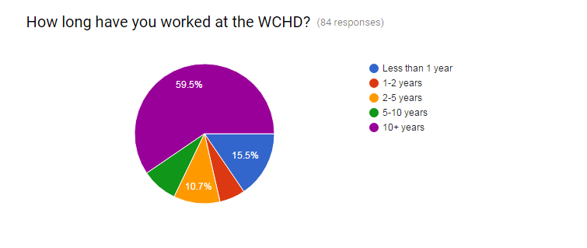
How long have you worked at the WCHD?
8.3%
6%
Only one person did not respond to this question.
The majority of respondents have worked here 10+ years and they were the most likely to respond to the open ended questions.

Slide 70
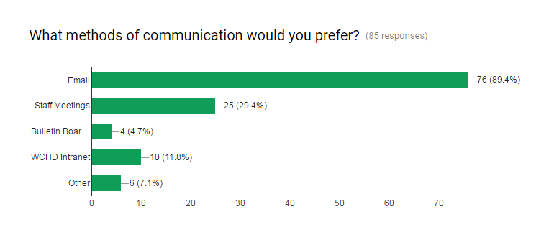
What methods of communication would you prefer?
Bulletin Board Notices
Other: New letter (10+), someone from Behavioral Health present at staff meeting (10+, comment about behavioral health), face to face (<1), Text message alerts (2-5, never has meetings), Division meetings (<1, never has meetings), face to face with supervisor (5-10, comment about change happening to them not with)
Everyone responded to this question.
Of those that did not select Email as a preferred method of communication, one said Intranet and the rest said Staff Meetings.

Slide 71
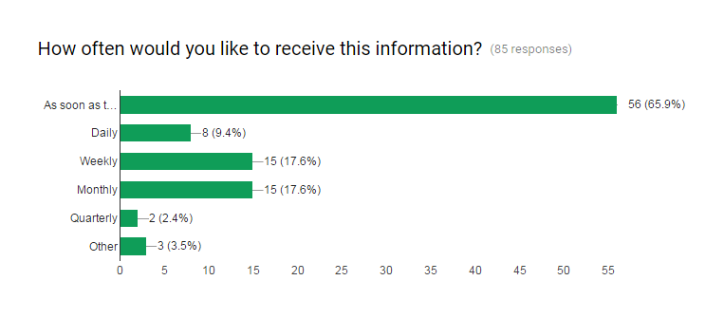
How often would you like to receive this information?
As soon as there’s anything new
Other: quarterly meetings, weekly updates (10+), as soon as possible if it is something significant or directly impacting my work (5-10), Updates yearly (10+, comment about good work being done)
Everyone responded to this question.

Slide 72
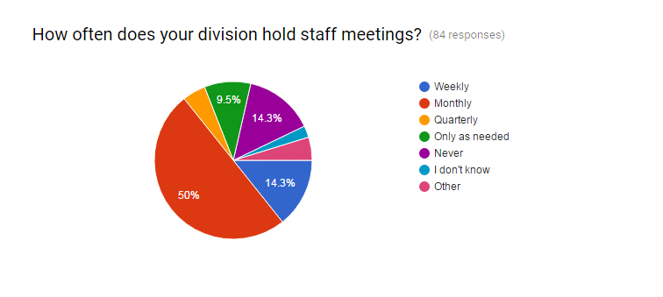
How often does your division hold staff meetings?
By years of employment at WCHD:
10+: 23 Monthly, 6 Weekly, 4 Quarterly, 5 as needed, 8 Never, 1 I don’t know, 1 bi-monthly, 1 bi-weekly
5-10: 3 Monthly, 2 Never, 1 I don’t know
2-5: 6 Monthly, 2 Weekly, 1 Never, 1 too often
1-2: 4 Monthly, 1 Never
<1: 5 Monthly, 4 Weekly, 2 as needed, 1 Never
4.8%
2.4%
4.8%
Other: Bi-Monthly (10+), bi-weekly (10+), too often (2-5), The division does not conduct staff meetings; however, I meet weekly with the Division Director. (10+, comment about information that may/will impact operations, I counted this as Never)
Only one person did not respond to this question.

Slide 73
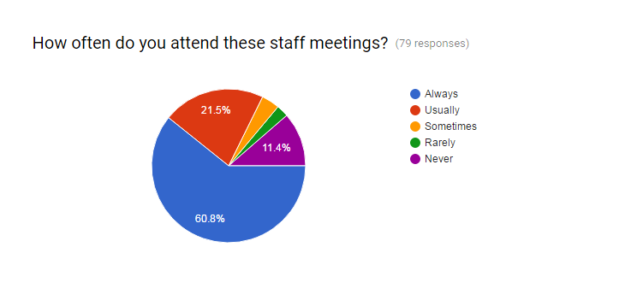
How often do you attend these staff meetings?
By years of employment at WCHD:
10+: 26 Always, 13 Usually, 2 Sometimes, 1 Never
5-10: 2 Always, 1 Usually, 1 Rarely
2-5: 6 Always, 1 Usually, 1 Sometimes, 1 Rarely
1-2: 3 Always, 1 Usually
<1: 9 Always, 1 Usually, 1 Never
3.8%
2.5%
Seven people who said their division never has staff meetings responded Never to this question as well, so I did not count those who said their divisions never have staff meetings.

Slide 74
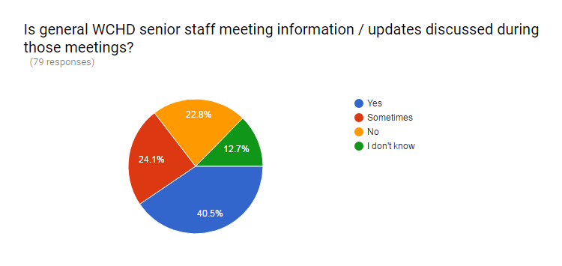
Is general WCHD senior staff meeting information / updates discussed during those meetings?
By years of employment at WCHD:
10+: 15 Yes, 14 Sometimes, 8 No, 3 I don’t know
5-10: 1 Yes, 2 Sometimes, 1 I don’t know
2-5: 7 Yes, 1 No, 1 I don’t know
1-2: 1 Yes, 2 Sometimes, 1 I don’t know
<1: 6 Yes, 2 Sometimes, 2 I don’t know
Some people who said their division never has staff meetings or that they never attend meetings responded No (8 respondents) or I don’t know (2 respondents) to this question as well, so I did not count those who said their divisions never have staff meetings or they never attend staff meetings.

Slide 75
What would you like to receive more communication about?
There were 29 total responses to this question.
21 were from employees who have worked here 10+ years (plus answers of “yes” and “n/a” which I didn’t count), 1 from 2-5 years, 1 from 1-2 years, and 4 from those who have worked here less than 1 year.
I organized them and listed some of the most common themes in the responses.
A * indicates that the same person also responded to the other comments question; look for the * with the same number on that response.
The + number indicates the number of other responses to both open ended questions that mentioned that topic.

Slide 76
What would you like to receive more communication about?
New/Changing Programs + 4
new programs and initiatives, new employees, (<1)
New initiatives (10+)
Program updates (10+)
News regarding what other programs/services are new to the Health Department. (10+)*3
New programs available, new staff, open positions, upcoming changes (10+, never has meetings)*4
NEW HIRES, TRAININGS BEING HELD HERE, ANYTHING THAT THE PUBLIC MAY QUESTION ME ABOUT AT HEALTH FAIRS OR HOME VISITS, POSITIONS AVAILABLE HERE WITHOUT HAVING TO GO ON THE WEBSITE, ANY NEW PROGAMS THAT ARE ADDED. (10+)*7
Employee news...happy stuff. New services and happenings in other programs (10+)*8
Program activities - new personnel - new programs (10+)*9

Slide 77
What would you like to receive more communication about?
What other divisions do/services offered + 2
I would like to know what everyone does within the health department, what resources are available to us as staff and have an easier way to communicate these resources to the community. (<1)
Information about role and function of programs in each division of the department; Information about job duties and roles of individuals in each program and each division of the department; Updates on special projects programs may be working on so that programs can refer to each other if the projects relate to a need of a patient/participant (2-5, never has meetings)
What other agencies are offering. No idea what offered at Behavioral Health and WIC is located right next door. (10+)
New hires, transfers, what precisely departments do (10+)*1
What other divsions do and servivces they provide. It would be very helpful to know our own interagency resources. (10+, never has meetings)
services offered through the WCHD to the public (10+)*5
Periodic updates describing program and highlighting work being done. (10+)*10

Slide 78
What would you like to receive more communication about?
General what’s going on in the health department info + 2
Events and updates about things going on at the Health Department (<1)
The happenings of the Health Department (1-2, never has meetings)
Programs on the horizon for the HD as a whole and particularly in my division or program (10+)*2
General info that affects the day-to-day operation of the Health Department and me as an employee; events sponsored by the Health Department in the community; State of the Union (Health Department) info (10+)
Information that may or will impact the operations of the agency and/or it's current or future personnel. For example, changes to front desk procedures for incoming visitors (visitors must sign-in, or not sign-in), dissolution of new employee orientation. (10+)
Anything that relates to employees, and my division. (10+)
It would be good to hear the questions and concerns that other employees have that may or may not concern me or my department (10+, never has meetings)
I would like to see what is discussed from Management as we received in the past. These notes are very informative with the direction we as an agency are moving and contained vital information that we would not otherwise hear about. Staff workers are a very integral part of the work that is being completed for the agency. Communication is a very important element for all employees as this helps aid in continuity of the agency. (10+)*6
Communication within individual division (10+, never has meetings)

Slide 79
What would you like to receive more communication about?
Other
Any upcoming training that needs to be completed. (<1)
I feel that I am adequately communicated with (10+)
Other Topics Mentioned
Personnel Changes/Information: 5 + 6
Job Openings: 2
Trainings: 2 + 1

Slide 80
Other Comments or Suggestions
There were 16 responses to this question.
14 were from employees who have worked here 10+ years, 1 from 5-10 years, and 1 from 2-5 years.
Only people who have worked here 10+ years responded to both open ended questions.

Slide 81
Internal/WCHD Considerations:
Key Takeaways
Significant uncertainty and concern exist given unknown funding changes and health reform implications…most believe changes must be made for WCHD to survive and/or succeed:
WCHD staff generally seen as a strength by those surveyed, but…
  Concerns exist relative to staff shortages today, and even more so in the future given pending retirements
  Job satisfaction (along with shortages) cited as greatest area for improvement
  A desire also exists for improved communication, onboarding processes, department efficiencies, and staff training
Strong desire exists for increased community outreach and collaboration…at the same time the majority of staff aren’t aware of current CHNA, a significant example of both those efforts.
Improved communication and collaboration appears necessary both within WCHD (cross-divisional) and between WCHD and the community

Slide 82
Situation Assessment Findings:
Health and Community Leader Survey Results

Slide 83
Health and Community Leader Survey:
Respondents
Total respondents: 28*
*Please note that responses by question may vary. 28 people started the survey and 28 completed the survey by clicking submit at the conclusion…but some may not have answered all questions.

Slide 84
Health and Community Leader Survey:
What Essential Services Should be Top Priorities

Slide 85
Health and Community Leader Survey:
Awareness of WCHD Services
Where would you go to find out about WCHD’s programs and services?

Slide 86
Health and Community Leader Survey:
Top Strengths of WCHD

Slide 87
Health and Community Leader Survey:
Interaction with WCHD
Which of the following best describes your organization’s
interaction with WCHD?

Slide 88
Health and Community Leader Survey:
How should WCHD Adapt
How do you see WCHD evolving to adapt to changes in public health and healthcare? Please select all that apply.

Slide 89
Health and Community Leader Survey:
How to Enhance Relationship
In what way(s) could WCHD enhance its relationship with your organization? Please select all that apply.

Slide 90
Health and Community Leader Survey:
Top Community Health Needs

Slide 91
Needs Most Appropriately/Sufficiently
Addressed by WCHD

Slide 92
Needs Not Being As Appropriately/Sufficiently
Addressed by WCHD

Slide 93
Health and Community Leader Survey:
Key Findings
Perception...WCHD primarily exists to:
  Inform, educate, and empower people about health issues
  Lowest priority relates to researching new insights and innovative solutions to health problems
Staff experience, community outreach, and collaborative efforts cited as WCHD strengths…however, most acknowledged that expanded/increased outreach and collaborative efforts will be necessary for WCHD going forward
Both Mental Health and Behavioral Health rose to the surface as the greatest health needs for the community…and many felt WCHD is going a good job working to address those need areas

Slide 94
Where Are We Going?
Mission, Vision, and Values

Slide 95
Strategic Planning Continuum
Organizational Level
Divisional Level
Vision: Our Hope
Mission: Our Purpose
SWOT
Goals
Strategies
Objectives
Tactics
Values: Our Guiding Principles
Decreasing Consultant Input
Increasing Consultant Facilitation

Slide 96
Mission and Vision Statement
WCHD’s Mission
Promote healthy behaviors, prevent disease and injury, and safeguard the environment
WCHD’s Vision
A healthy community for all

Slide 97
Core Values
Respect
Excellence
Commitment
Integrity
Professionalism
Equity

Slide 98
Strategic Direction & SWOT

Slide 99
WCHD Strengths and Weaknesses
WCHD Strengths
Staff expertise, responsiveness, and commitment Collaboration with community partners Scope of services to meet needs of our community Responsiveness to emergent or immediate health concerns
WCHD Weaknesses
Communication and collaboration (both internally and externally) Staff – Onboarding and training (impacts efficiencies and customer services) Internal technological capabilities (data collection and integration External technology (web, social media, etc.)

Slide 100
External Opportunities and Threats
External Opportunities
Federal/State Legislative/Policy Changes Increasing community partnerships Services for 65+ population/other fee-for-service Population growth (incl. those in poverty) Drug abuse/treatment Chronic disease management Child wellness Emerging disease Connecting to resources
External Threats
Opioid/Other Drug Epidemic Federal/State Legislative/Policy Changes Funding Poverty/Homelessness Environmental issues Unhealthy lifestyle/culture Lack of post-high school education/workforce availability

Slide 101
Strategic Position Matrix
How is WCHD positioned based on S.W.O.T. analysis?
Staff expertise, responsiveness, and commitment
Collaboration with community partners
Scope of services to meet needs of our community
Responsiveness to emergent or immediate health concerns
Communication and collaboration (both internally and externally)
Staff – Onboarding and training (impacts efficiencies and customer services)
Internal technological capabilities (data collection and integration
External technology (web, social media, etc.)
Federal/State Legislative/Policy Changes
Increasing community partnerships
Services for 65+ population/other fee-for-service
Population growth (incl. those in poverty)
Drug abuse/treatment
Chronic disease management
Child wellness
Emerging disease
Connecting to resources
WCHD Strengths
WCHD Weaknesses
Program Expansion or Development (O/S) | Program Enhancement (O/W)
Program Evaluation and Prioritization (T/S) | Program Consolidation or Contraction (T/W)
External Opportunities
Opioid/Other Drug Epidemic
Federal/State Legislative/Policy Changes
Funding
Poverty/Homelessness
Environmental issues
Unhealthy lifestyle/culture
Lack of post-high school education/workforce availability
External Threats

Slide 102
Strategic Planning Continuum
Organizational Level
Divisional Level
Vision: Our Hope
Mission: Our Purpose
SWOT
Goals
Strategies
Objectives
Tactics
Values: Our Guiding Principles
Decreasing Consultant Input
Increasing Consultant Facilitation

Slide 103
WCHD’s
Wildly Important Goals (WIGs) Id’d in strategic planning
Which of the following Goal Areas are most critical to WCHD’s future success? Why? How might we measure success in these areas?
Collaboration - Across divisions; With community organizations
Community outreach and education (including tech, web, social media)
Internal efficiencies and communication (including technology/data)
Future staff identification and onboarding
Staff education and training

Slide 104
Strategy 1:
Promote Collaboration and Empower Staff
Develop a collaborative culture at WCHD by empowering and educating employees, refining roles, fully leveraging technology, and enhancing communication methods within and across divisions.
Rationale:
Strengthens required foundation to support and advance other strategies
Positions WCHD to better adapt to future changes by empowering WCHD employees to impact change
Established process/structure for employee succession
Enhances divisional coordination and communication
Expands the organizational capacity of WCHD
Further develops employees to fulfill roles most necessary for WCHD to achieve its mission
Assists with maximizing department effectiveness

Slide 105
Strategy 1: Objectives/Key Actions (Responsible persons/completion)
Objective 1 : Enhance internal communication across divisions
1. Follow- up communications survey
(Rod MacCrae /
2. Lunch and learn Q&A sessions by senior
leadership (Earl Stoner, Diana Gaviria /

Slide 106
Strategy 1: Objectives/Key Actions
(Responsible persons/completion)
Objective 2: 100% of new staff will be proficient in IT communication tools within 3 months
1. Develop checklist of all required trainings
( Director / January 2018)
2. Develop training materials for those tools that
do not already have training materials
( designated staff / Jan. 2018)
3. Develop Proficiency Evaluation tool
( designated staff / Jan. 2018)

Slide 107
Strategy 1: Objectives/Key Actions
(Responsible persons/completion)
Objective 3: Develop collaborative culture and empower staff through education
1. ID MS22 position description for each employee with measurable performance evaluation standards (supervisor and employee/ within 1 month of hire/transfer)
2. Update program policies and procedures to ensure application consistencies (Employee, supervisor, manager/ annually)
3. Weekly staff meetings to address developing and ongoing business; discuss collaborative efforts (internal,external ,customer) (director, manager/ weekly)

Slide 108
Strategy 1 ( objective 3 cont.)
Develop collaborative culture and empower staff through education
4. Measure success through PEP process (director/q 6 mos)
5. Incorporate technology to support internal goals
(supervisor,manager,director / q 3 months)

Slide 109
Strategy 1: Objectives/Key Actions
(Responsible persons/completion)
Objective 4: All staff will attend an annual training on all communication and informational tools
1. Assign training person (designated staff/ Jan. 2018)
2. Prepare updates on each tool, e.g calendar, WCHD website, DHMH website, intranet (designated staff/ Jan. 2018)
3. Develop annual training schedule with quarterly classes
( designated staff/ Jan. 2018)
4. Maintain training/update log (designated staff, Jan. 2018)
5. Provide passing certificate (designated staff, Jan. 2018)

Slide 110
Strategy 1: Objectives
Objective 5: Ensure professional and competent staff for future growth and development
1. Ensure and provide continuing education unit opportunities for staff licensure ( all staff to do, supervisor to check / monthly)
2. Reach out to state/local experts for education training opportunities ( manager/ as needed)
3. Discuss employee goals and promotional opportunities
(Employee, supervisor/ monthly)
4. Review MS22/PEP (employee, supervisor/ 6 months)

Slide 111
Strategy 2:
Enhance Community Awareness and Experience
Expand the public’s awareness of all WCHD’s services and pursue excellence in the area of customer experience. Accelerate measurable, sustainable improvement in outreach and customer satisfaction.
Rationale:
Provides platform for making community more aware of our programs, services, and community partnerships
Supports mission by making the community more aware of WCHD
Leverages technology to expand efforts to reach the community “where they are”
Establishes culture of service excellence as foundation for future WCHD growth and development
Enhances community’s perception of WCHD
Further increases WCHD’s effectiveness at impacting health among multiple cultures

Slide 112
Strategy 2: Objectives/ Key Actions
(responsible persons/completion)
Objective 1: Increase/expand community awareness
1. Increase public health week activities ( Danielle, Hannah/ )
2. Improve website (Danielle, Hannah / )
3. Update literature, handouts (director, staff/ 6 months)
4. Facebook page for notifications (wells, water samples, rabies) (IT managers/ 6 months )
5. Continue attendance with local community groups, radio, TV (all/ as needed)

Slide 113
Strategy 2: Objectives
Objective 2: Enhance customer service
1. DHMH customer service training ( Rod MacRae
2. Train front office for delivery of consistent message
( office supervisor/ hire or quarterly)
3. Cross-training for new employees (Supervisor/quarterly)
4. Increase education and awareness of other programs, e.g. BRF, Social Services, Habitat for Humanity etc. (managers/quarterly)
5. Training/evaluation for each employee MS22/PEP (supervisor/6 months)
6. Automate database and filing systems (director, health officer/6 months)

Slide 114
Strategy 2: Objectives
Objective 3: Leverage technology
1. Acquire trained GIS staff to map data to guide strategic practices (GIS tech, all staff/ daily)
2. Technology (phone, PC, tablet) integration (all staff/daily)
3. Use mapping tools for exploring potential environmental impacts (supervisor/ as needed)
4. Share maps with communities, local jurisdictions, state, etc. (all staff; as needed)
5. Provide ongoing trainings with technologies (all staff/monthly)

Slide 115
Strategy 2: Objectives
Develop new website within one year
1. specific program information; brochure/formatting
(program staff/ Jan. 2018)
2. updated website/ formatting
(contractor/ Jan. 2018)
3. contract with web designer (contractor/ Jan. 2018)
4. self-referral and customer satisfactions surveys re consumer experience (program staff / Jan. 2018)

Slide 116
Strategy 3:
Refine Structure for Evaluating Programs/Services
Enhance capacity to evaluate and prioritize programs and services to ensure most appropriate resource allocation and department-wide efficiencies.
Rationale:
Establishes framework for consistent/routine evaluation
Allows WCHD to most fully leverage its core strengths
Provides foundation for accelerating the improvement of our community’s health
Assists WCHD and its community partners with implications of health reform and ongoing future changes
Strengthens WCHD’s relevance in a rapidly evolving environment
Most appropriately leverages already-limited resources, including staff
Bolsters against funding instability

Slide 117
Strategy 3: Objectives/Key Actions
(responsible persons/completion)
Objective 1: Develop Performance Management/QI plans
1. Work w consultant (
Objective 2: Ensure optimal WCHD efficiencies
1. Evaluate programs by PEPs, data (senior mgmt/annually)
2. Identify areas in need of resource upgrade (sr.mgmt/annually)
3. Automate filing systems and integrate w state, local agencies, and customers (sr. mgmt, director / annually)

Slide 118
Strategy 3: Objectives
Objective 3: Evaluate and prioritize programs for resource allocation
1. Ensure WCHD mandated programs are fully funded
(sr. management / annually)
2. Prioritize programs within envtal health based on public and environmental health (director / 6 months)
3. Prioritize WCHD programs and ensure state ratios are fulfilled (senior management / 6 months)
4. Prioritize funding and resources (senior mgmt/ 6 mos)
5. Request INC fees and coordinate w Washington County
(Health Officer, director / annually )

Slide 119
Key Support functions

Slide 120
Linkages to QI Plan and CHIP

Slide 121
Assessment and Reporting
Strategic Plan implementation progress will be reviewed every six months by Senior Management Group
Assessment matrix will be developed for reporting on implementation progress

